Slide 1
National Team Analytical System From 1872 To 2025

Slide 2
Introduction
In this project, I built a complete analytical system designed to process, organize, and visualize historical football data across all national teams worldwide. The system provides a unified and intelligent way to explore tournaments, teams, players, continents, regions, and ethnic groups using a fully interactive and drill-down-enabled dashboard.
Through advanced data cleaning, modeling, warehousing, and visualization techniques, the project delivers deep insights into football performance, supporting strategic analysis and helping users understand patterns, strengths, and weaknesses across every national team in history.

Slide 3
This project went through four main stages to build a complete analytical system for international football statistics.
1) Dataset Collection And Description
2) Data Cleaning and Preparation
3) Data Warehousing
4) Data Analysis and Visualization

Slide 4
Dataset Description

Slide 5
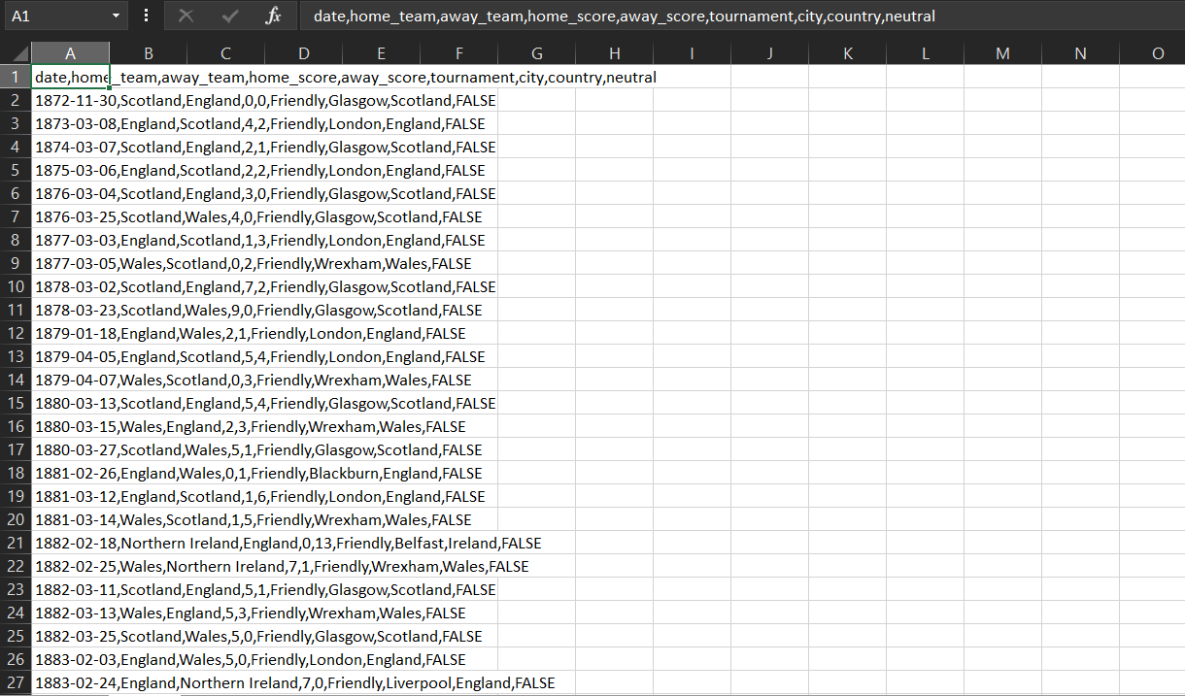
I obtained a dataset consisting of two files. The first file contains the names of the national teams that played against each other, along with the match date, tournament name, goals scored by each team, the host country, the host city, and an indicator showing whether the match was played on neutral ground

Slide 6
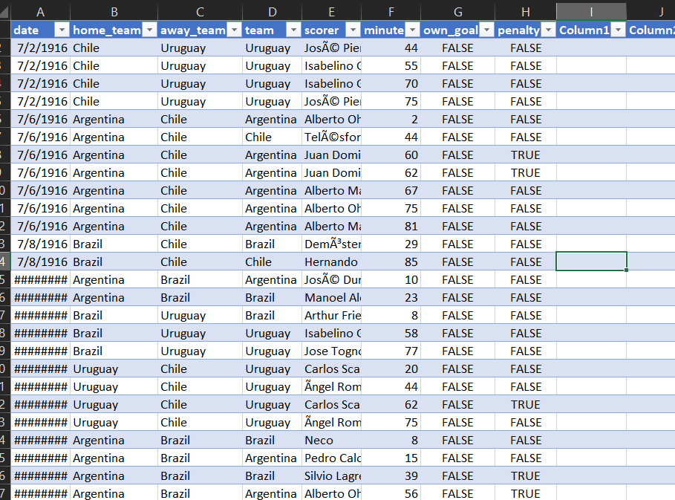
The second file is an extension of the first one, containing data about the players who scored the goals. It includes the home and away teams, the minute each goal was scored, the player’s name, the match date, and flags indicating whether the goal was an own goal or a penalty And The Team Which Score The Goal. Note: The second file is not fully reliable, as it doesn’t include all matches from the first file — it contains significantly fewer records.

Slide 7
Data Cleaning and Preparation
During the second stage, I performed data cleaning and added several new columns.

Slide 8
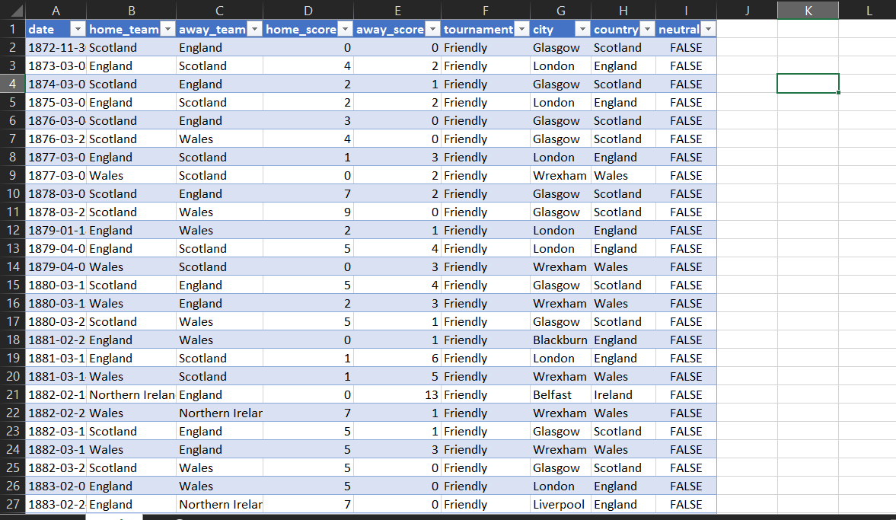
First, I converted the sheet into a structured table (instead of a raw CSV format) using the Text to Columns feature, setting the delimiter to a comma.
First Shape Of Data
After Making It As Column

Slide 9
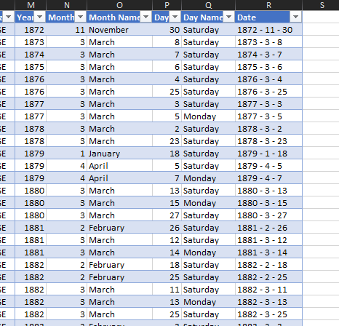
Then, I split the date column into day, month, year, and month name using Power Query, since dates earlier than 1900 couldn’t be properly recognized by Excel.

Slide 10
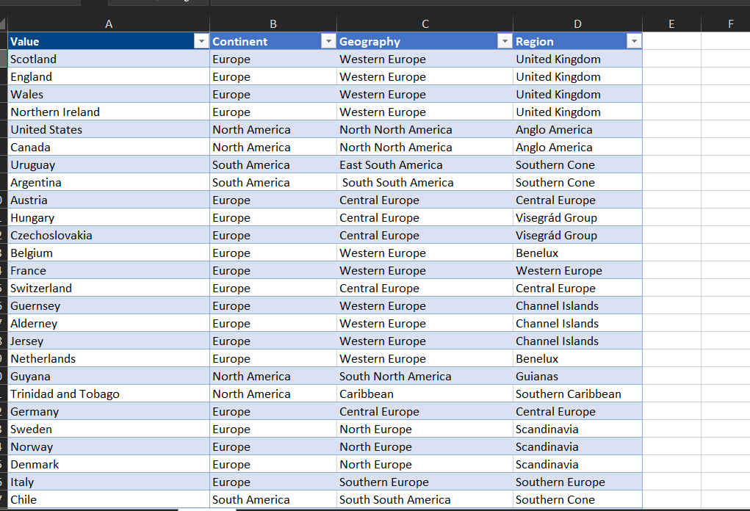
I also extracted all the countries listed in the sheet, copied them to a new sheet, removed duplicates, and added their corresponding continent, region, and ethnic group information. Continent: Classifies each country by its continent. Some countries span or participate in more than one continent. For example: Asia/Europe: Kazakhstan, Turkey Asia/Oceania: Australia Region: Represents the geographic region of each country. For example: North Africa Central Europe East Asia Ethnic Group: Classifies countries based on predominant ethnic groups. For example: Arab – e.g., Egypt, Saudi Arabia Balkan – e.g., Serbia, Croatia Non-Arab African – e.g., Nigeria, Ghana This classification allows for flexible and accurate analysis of teams and matches across continents, regions, and ethnic groups.

Slide 11
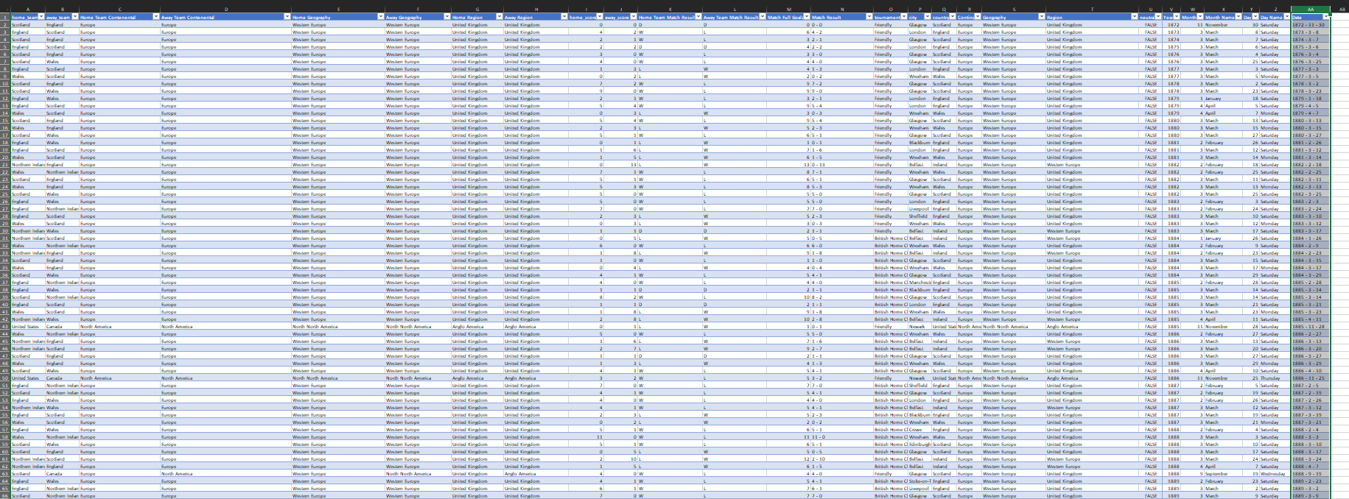
After that, I used a lookup function to bring the continent names into the original sheet for each country — including the home team, away team, and host country.

Slide 12
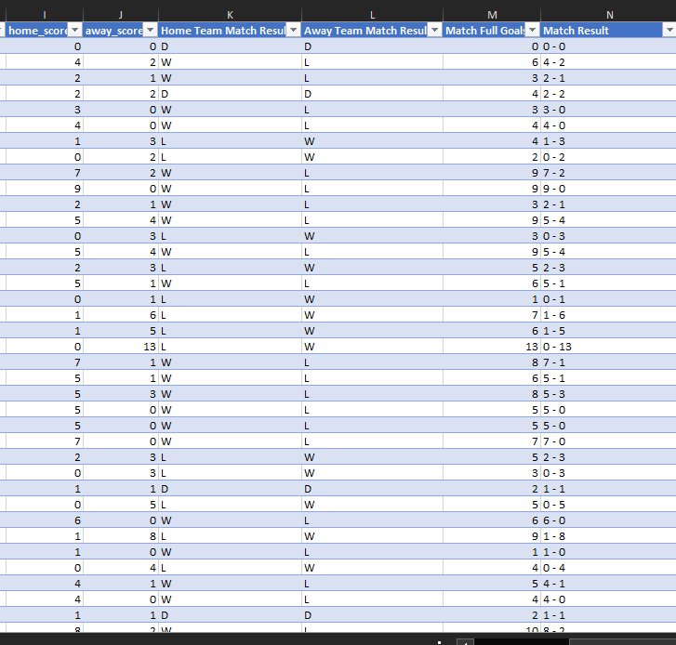
Finally, I added new columns to calculate the total number of goals per match, the match score, and the match result (W, L, D) for both home and away teams, indicating whether they won, lost, or drew.

Slide 13
Players’ Sheet (Second Sheet)
The second sheet is the one related to the players who scored the goals.

Slide 14
The first challenge was to link both sheets so that each match in the first sheet corresponds to the relevant data in the second sheet. This was difficult because there was no unique column to connect them using the date wasn’t reliable since multiple matches could occur on the same day, and using the home and away teams alone didn’t indicate when the teams faced each other

Slide 15
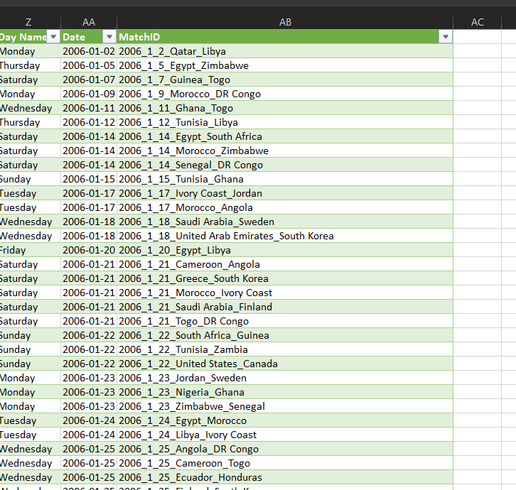
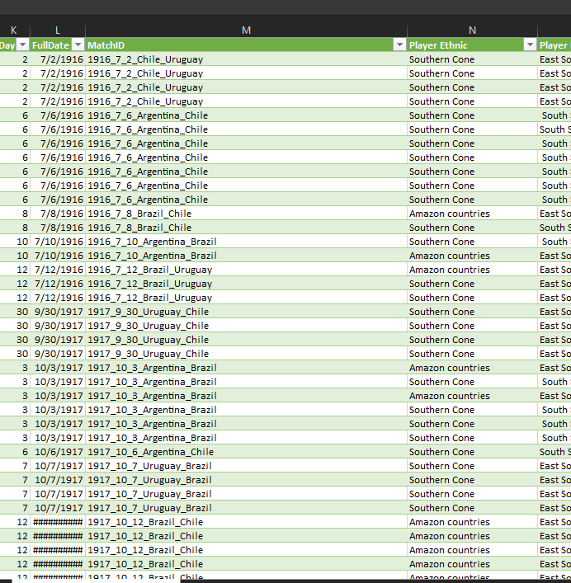
Therefore, I created a custom unique identifier column called “Match ID.” I built this column in Power Query by concatenating the home team name, away team name, and match date (day, month, and year) to ensure every match had a unique ID. After generating the same column in both sheets, I performed a merge operation in Power Query to combine the necessary data from the first sheet into the players’ sheet.

Slide 16
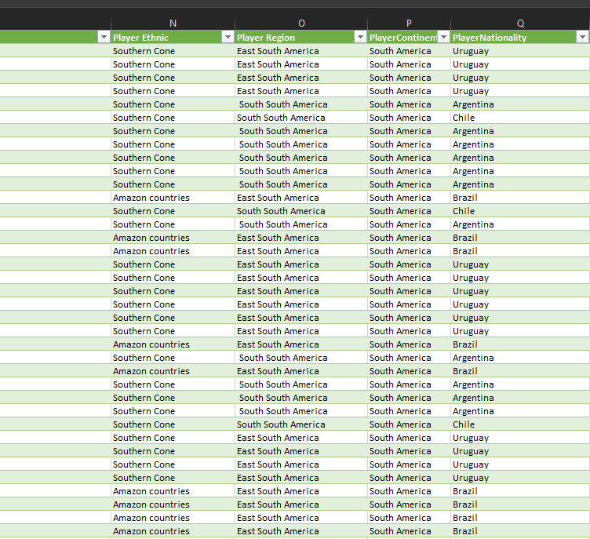
The last challenge in the players’ sheet was that it did not contain the nationality of the player who scored the goal. This was difficult to determine because if a player scored an own goal, the goal is counted for the opposing team rather than the player’s actual national team. Therefore, identifying the correct nationality was not straightforward. To solve this, I created a formula in Excel using Power Query to determine the player’s nationality. If the Own Goal flag was false, I returned the nationality of the team the player belongs to. If the Own Goal flag was true, I returned the nationality of the opposing team instead. Based on this logic, I was able to retrieve the player’s nationality, continent, region, and ethnic group accurately.

Slide 17
Data Warehousing This stage involves building the data warehouse and splitting the main file into structured database tables, including dimensions and fact tables.
In this phase, I used Power BI, SQL Server, Dax Studio, and SSIS

Slide 18
I divided my file into seven dimensions and two facts. The seven dimensions are:
DimDate – contains the full date, month, year, and day. DimCity – contains the city name. DimTeam – contains the team name along with its continent, region, and ethnic group. DimPlayer – contains the player name. DimMatchID – contains the match ID, which I use to link the two sheets. DimTournament – contains the tournament name. DimMinuteRange – contains the minutes, which I divided into ranges in SQL using a specific query to facilitate analysis.

Slide 19
The two fact tables are FactMatch and FactPlayer.
FactMatch contains the surrogate keys (SK) for DimDate, DimCity, DimTournament, DimMatchID, as well as the HomeTeam_SK, AwayTeam_SK, and HostTeam_SK. I used role-playing dimensions for these team-related keys, and all of them come from DimTeam
FactPlayer contains the TeamScored_SK from DimTeam, as well as the Player_SK, Date_SK, and MinuteRange_SK. I also linked the two fact tables together by adding the Match_SK from FactMatch into FactPlayer, so I can create a relationship between them and bring any needed fields from FactMatch into FactPlayer.

Slide 20
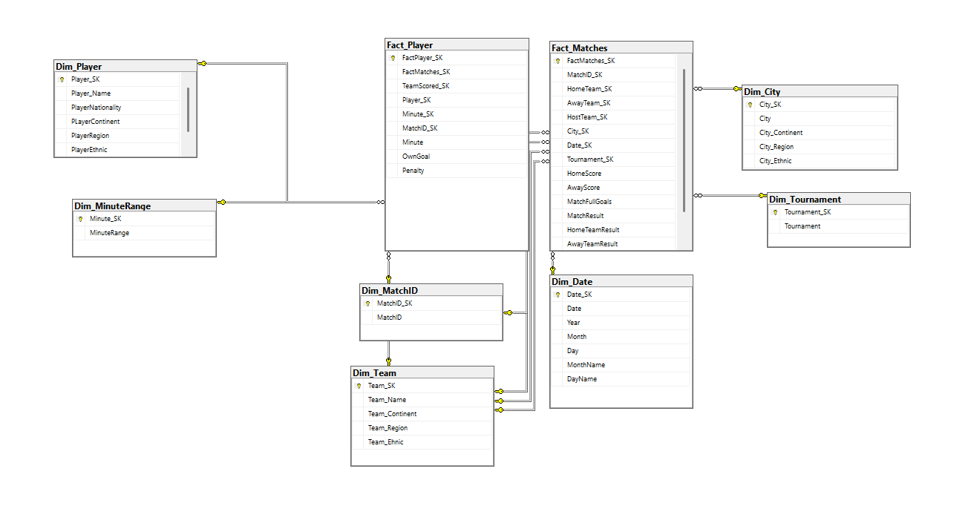
This is the diagram of the fact tables and dimensions. I was also careful to build the entire data warehouse in SQL Server so I could validate all the relationships using queries and joins, and ensure that both my data and the data warehouse are 100% accurate.

Slide 21
Data Analysis and Visualization
After completing the data warehousing stage, I moved on to analyzing the dataset and visualizing the insights.

Slide 22
I created four dashboards in total. The second and third dashboards are fully dependent on the first one, as they use its filters, context, and selected values to update their visuals dynamically. The fourth dashboard, however, is completely independent and functions separately from the other three.

Slide 23
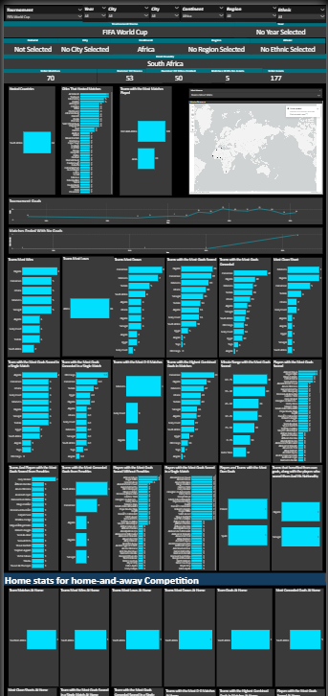
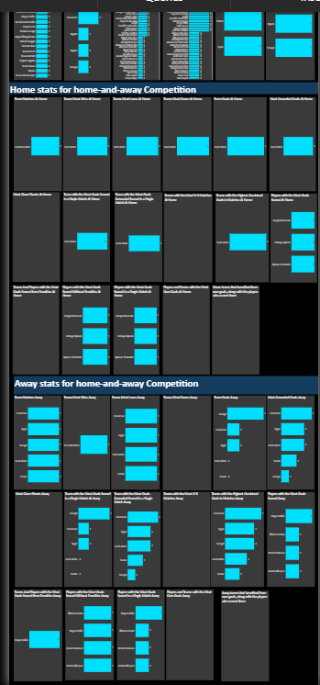
DASHBOARD 1 (Primary Dashboard)

Slide 24
In the first dashboard, the main focus is on general statistics for tournaments, continents, and cities. To allow flexible analysis, I created seven dropdowns. I will explain in detail what each dropdown does

Slide 25
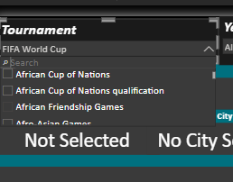
In the tournament dropdown, you can find all tournaments ever played in the history of international football.

Slide 26
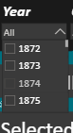
In the date dropdown, you have all years starting from the first international match ever played in 1872 — meaning all dates from 1872 up to 2025.

Slide 27
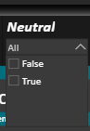
For the neutral-ground filter, you can leave it empty, or choose True if you want only matches played on neutral grounds, or False if you want matches that were not played on neutral grounds.

Slide 28
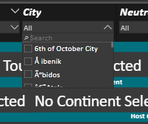
The city dropdown allows you to select any city where matches were played and view statistics for the countries that played in that city.

Slide 29
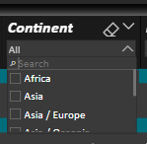
The continent dropdown includes all continents, allowing you to select any continent to base your analysis on. Asia/Europe : It is for the national teams which played for the two continent such turkey and Kazakhstan Asia/Austarlia : for the countries played to the two continent such australia

Slide 30
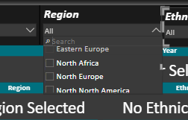
The region dropdown represents the geographic region of the national teams. As mentioned earlier, I classified all teams into geographic regions — for example: North Africa Central Europe etc.

Slide 31
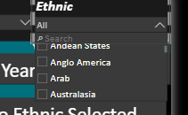
Finally, the ethnic dropdown allows analysis by ethnic group — for example: Arab teams only Balkan teams Non-Arab African teams and so on

Slide 32
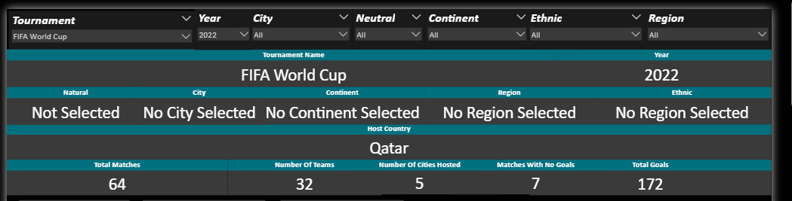
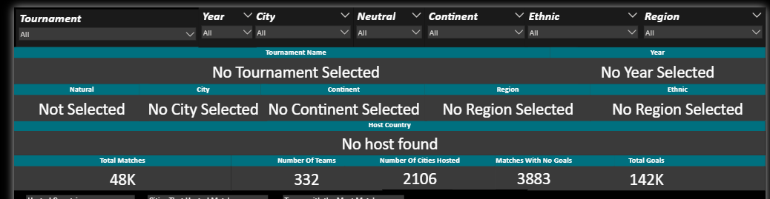
After that, when you select any tournament or any value from the dropdowns, the dashboard will display the tournament name, the date, or whatever you selected from the other dropdown menus. If you don’t select anything, it will show a message indicating that no filter has been chosen, and it will display the overall statistics. You have the flexibility to view the statistics in general, or for a specific year, a specific tournament, or without selecting any tournament at all. Below that, a card will show the host country of the selected tournament (if a tournament is selected), the total number of goals scored in that tournament, and the number of cities that hosted matches. If you select a continent instead, it will show all the cities within that continent that hosted matches in the selected year, along with the number of participating teams and the number of matches that ended 0–0 with no goals.
when selected any thing from dropdown
When not selecting and it show we have 48k matches in all history and 332 teams and that number of goals

Slide 33
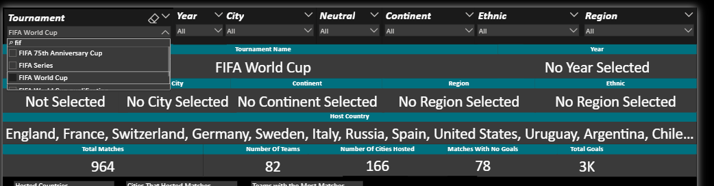
All tournaments and all dates are available, but I will explain the charts assuming that the selection is set to the World Cup across all historical years.

Slide 34
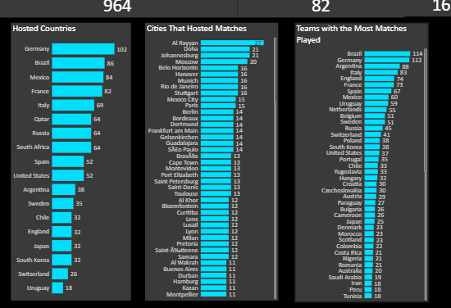
In these charts, it shows the country that hosted the most World Cup matches, the city that hosted the most matches, and the team that played the highest number of matches.

Slide 35
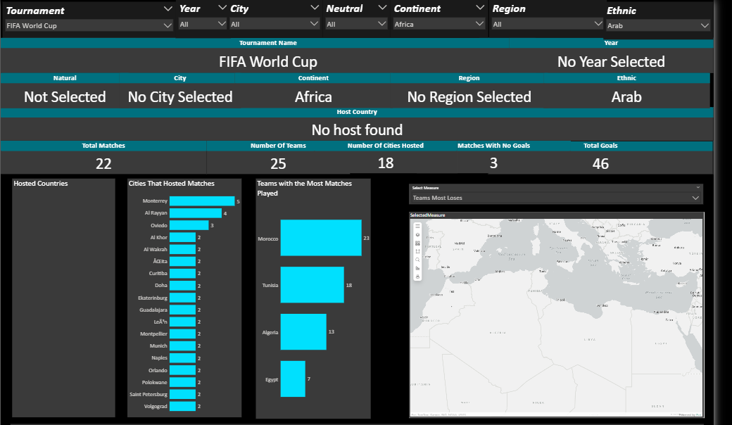
And if you select Africa from Continent Filter OR Arab In Ethnic Filter above, it will display only the African national teams Or Arab nationae team

Slide 36
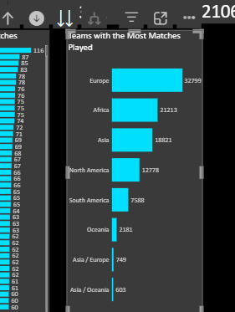
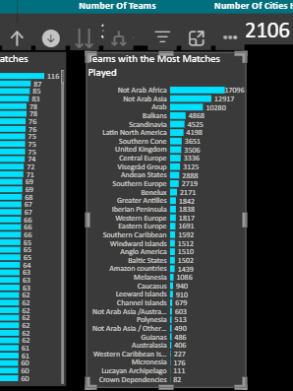
Many of the charts in my dashboard are hierarchy-based. By clicking on an arrow, it doesn’t just show the country that played the most matches—it also shows: The continent with the most matches Another arrow shows the region with the most matches Another arrow shows the ethnic group with the most matches This allows for drill-down analysis across different levels of the hierarchy.

Slide 37
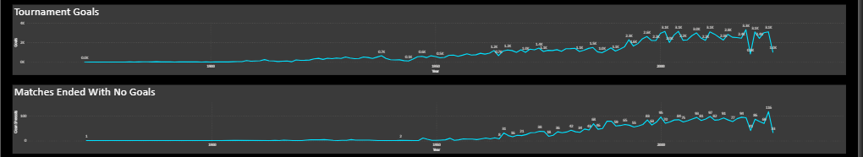
There is also a single line chart that shows: The highest number of goals scored in the tournament I selected across all historical years. The dates with the most matches that ended 0–0. From this, I can identify the strongest and weakest tournaments in terms of goals scored.

Slide 38
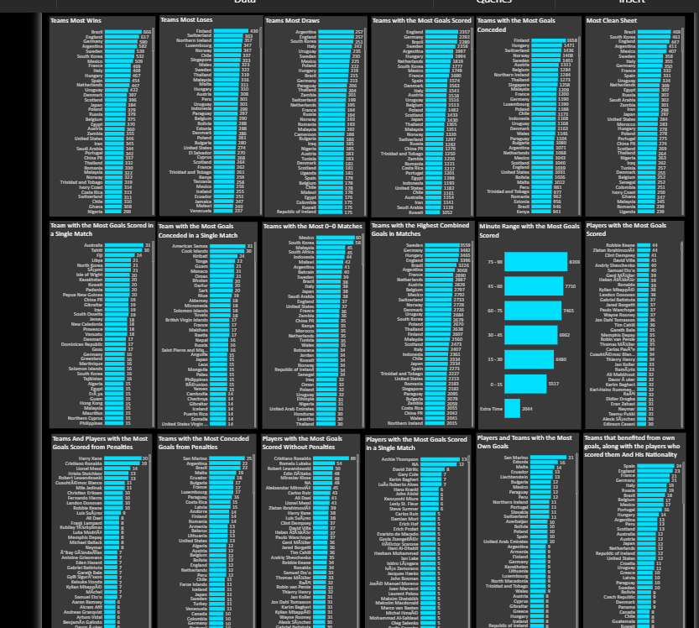
These charts provide more detailed insights for the selected tournament, continent, or any other filter. They show: The team with the most wins, most losses, and most draws The team that scored the most own goals and the team that conceded the most own goals The team with the most clean sheets The team that scored the most own goals in a single match and the team that conceded the most own goals in a single match The team with the most 0–0 matches The team whose matches had the most own goals, whether for or against them The average minute when own goals were scored Top goal scorers Players who scored the most own goals from penalties Players who scored the most own goals from non-penalties Players who scored the most own goals in a single match Players who scored own goals against themselves, or national teams that conceded own goals The teams that benefited the most from own goals

Slide 39
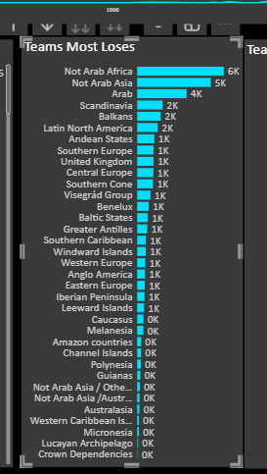
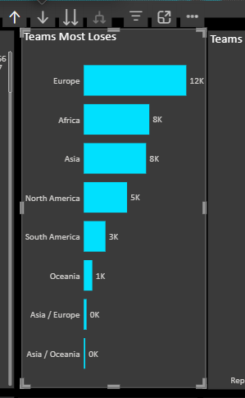
All of these charts, or most of them, also support hierarchy drill-down at any level—whether at the continent, region, or ethnic group level. This allows users to explore data from broader categories down to more detailed levels seamlessly.

Slide 40
Then, there are statistics for the teams that played home matches in tournaments that include home-and-away formats, such as the World Cup qualifiers.

Slide 41
I will set the filter to World Cup Qualifications and Africa as the continent, without selecting a specific year, so I can retrieve the overall home and away statistics for African teams in the World Cup qualification.

Slide 42
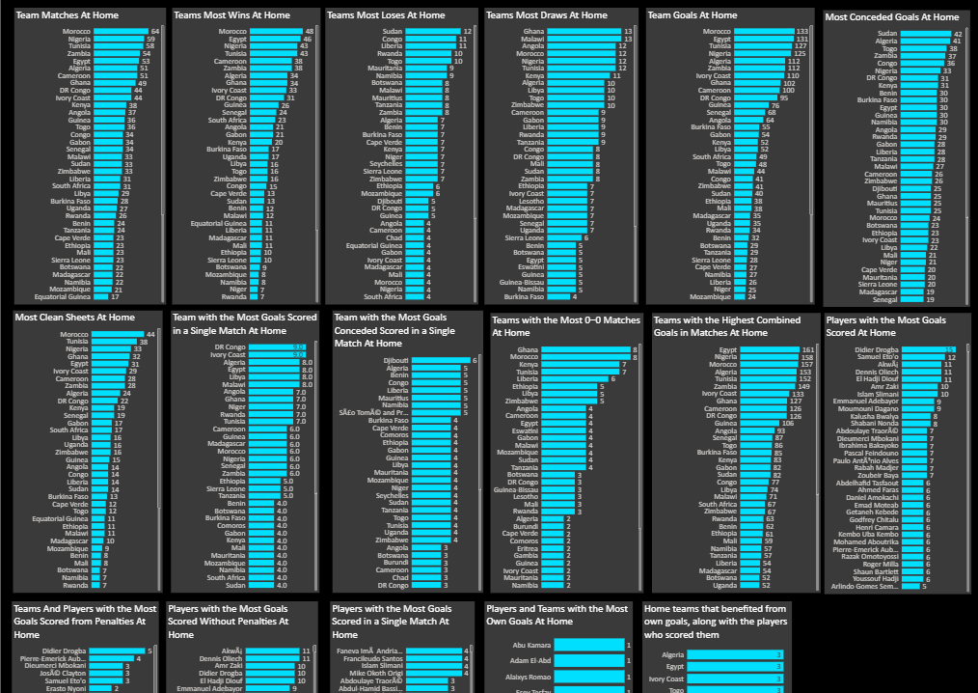
These charts provide deeper insights based on the selected tournament, continent, or any other filter. They show: The Team With The Most Matches (At Home) The team with the most wins (At Home) The team with the most losses (At Home) The team with the most draws (At Home) The team that scored the most goals (At Home) The team that conceded the most goals (At Home) The team with the most clean sheets (At Home) The team that scored the most goals in a single match (At Home) The team that conceded the most goals in a single match (At Home) The team with the highest number of 0–0 matches (At Home) The team whose matches had the most goals, whether scored or conceded (At Home) The top goal scorers (At Home) The players who scored the most penalty goals (At Home) The players who scored the most non-penalty goals (At Home) The players who scored the most goals in a single match (At Home) The players who scored own goals (At Home) The national teams that scored own goals (At Home) The national teams that benefited the most from own goals (At Home)

Slide 43
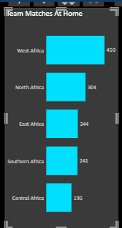
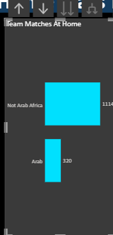
Most of these charts also support hierarchy drill-down, so by clicking on the arrows, you can view statistics by continent, region, and ethnic group.
Most Region Win In Africa World Cup qualification At Home
Most Ethnic Win In Africa World Cup qualification At home

Slide 44
Also, the charts include statistics for the tournament teams playing away (Away)

Slide 45
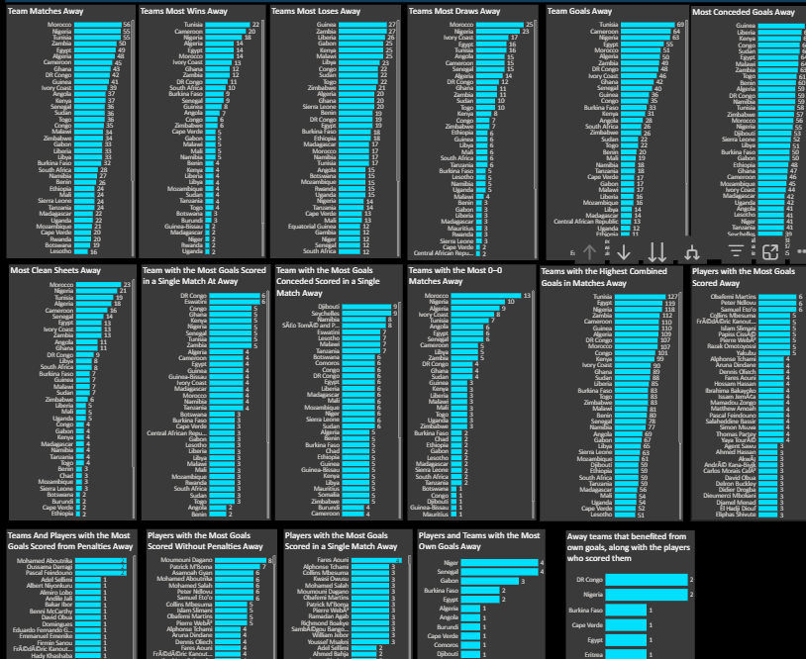
These charts provide deeper insights based on the selected tournament, continent, or any other filter. They show: The Team With The Most Matches (Away) The team with the most wins (Away) The team with the most losses (Away) The team with the most draws (Away) The team that scored the most goals (Away) The team that conceded the most goals (Away) The team with the most clean sheets (Away) The team that scored the most goals in a single match (Away) The team that conceded the most goals in a single match (Away) The team with the highest number of 0–0 matches (Away) The team whose matches had the most goals, whether scored or conceded (Away) The top goal scorers (Away) The players who scored the most penalty goals (Away) The players who scored the most non-penalty goals (Away) The players who scored the most goals in a single match (Away) The players who scored own goals (Away) The national teams that scored own goals (Away) The national teams that benefited the most from own goals (Away)

Slide 46
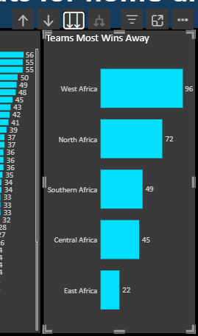
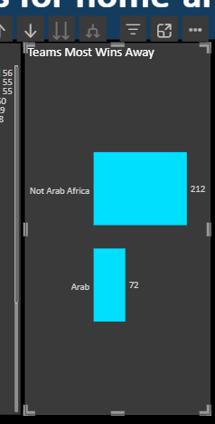
Also Most of these charts also support hierarchy drill-down, so by clicking on the arrows, you can view statistics by continent, region, and ethnic group.
Most Region Win In Africa World Cup qualification Away
Most Ethnic Win In Africa World Cup qualification Away

Slide 47
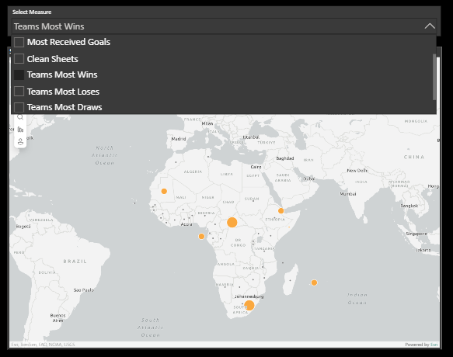
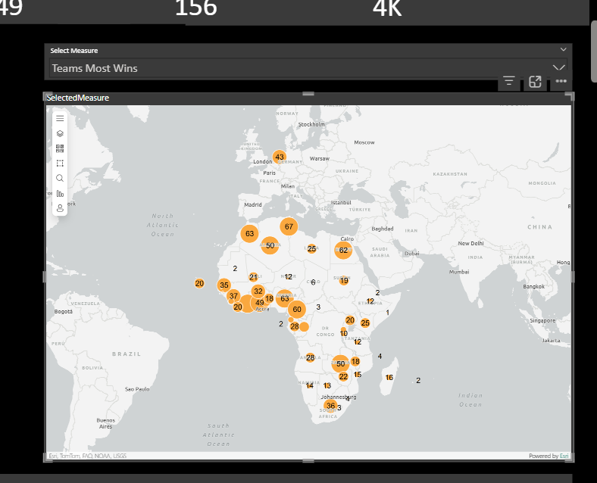
Also, in the same dashboard, there is a map where you can select any metric you want, such as the team with the most losses, the team with the most wins, the team that played the most matches, the team that scored the most goals, the team that conceded the most goals, or the team with the most clean sheets. Once you select a metric, it will be displayed directly on the map.

Slide 48
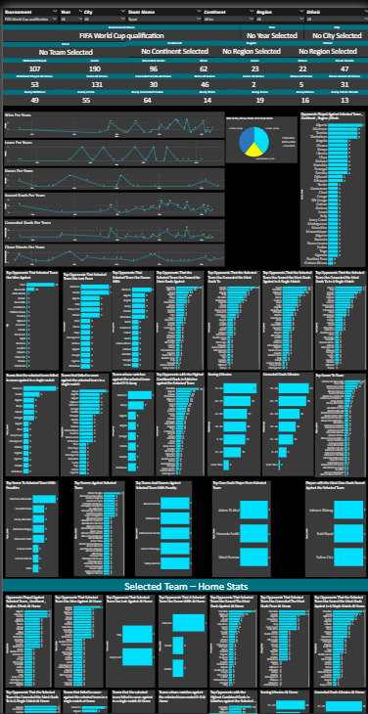
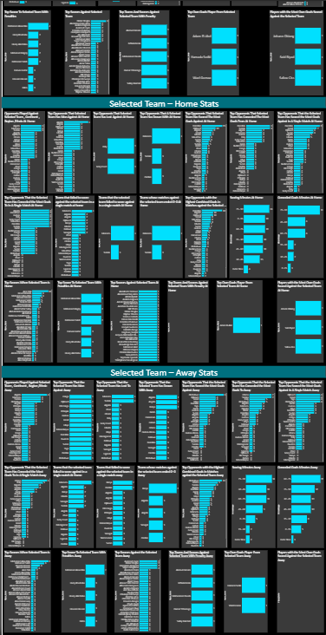
DASHBOARD 2

Slide 49
As mentioned, Dashboard 1 is primarily focused on tournament-level statistics, such as the team with the most wins in the tournament, the team with the most losses, and similar metrics. For tournaments with a home-and-away format, their statistics are also included. Dashboard 2, on the other hand, is mainly focused on the selected national team, continent, ethnic group, or region, allowing a more detailed analysis at these levels

Slide 50
At the beginning, Dashboard 2 also contains seven dropdowns. The tournament and date dropdowns are linked to selections made in Dashboard 1, so any choice of tournament or date in Dashboard 1 will automatically appear in Dashboard 2. However, you can freely change them in Dashboard 2 to any tournament you want. Additionally, there are dropdowns for team name, continent, ethnic group, region, and city to analyze the selected team’s statistics within that city. As I explain in the upcoming charts, I will first set the selection to the World Cup to make the explanation easier.

Slide 51
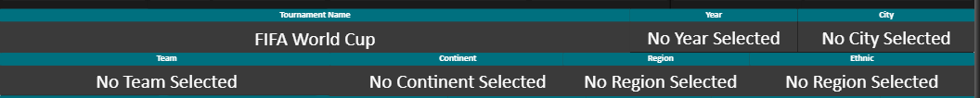
In Dashboard 2, I implemented dynamic cards that update automatically based on the user’s selections. When the user selects Tournament, Team, Year, City, Continent, Region, or Ethnic Group, the selected value is displayed immediately inside the card. If no selection is made, the card displays a clear message indicating that “No value is selected”, ensuring transparency and preventing confusion or misinterpretation of the data. All cards are fully dynamic and always reflect the current filter context in real time.

Slide 52
To simplify the explanation, I will now switch the selection to Africa World Cup qualification as the tournament, and Egypt as the chosen national team.

Slide 53
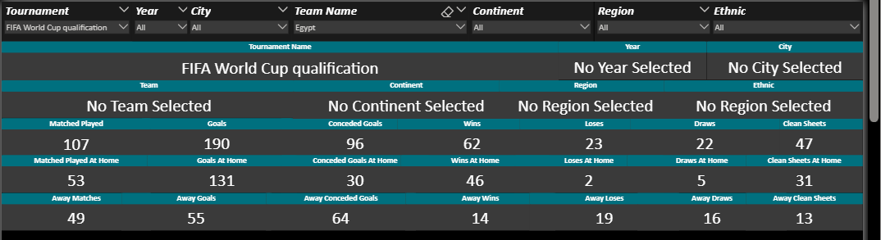
When a selection is made, a set of KPI cards is displayed showing Egypt’s statistics in the chosen tournament. These include: The total number of matches Egypt played Goals scored Goals conceded Number of wins Number of losses Number of draws Number of clean sheets And if home/away data exists for the tournament, separate KPIs for home and away matches are also shown with the same metrics.

Slide 54
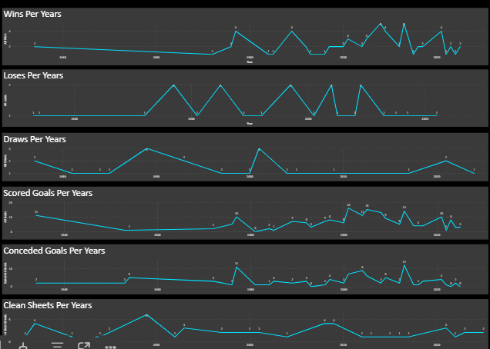
I also created four line charts that show, for the selected tournament, the years in which Egypt achieved the following: The highest number of wins The highest number of losses The most goals scored The most goals conceded The most clean sheets These charts provide a year-by-year trend to clearly highlight Egypt’s performance peaks in each metric based on the selected tournament.

Slide 55
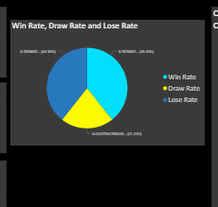
And I make pie chart to display win rate and lose rate for the selected team in selected tournamanet

Slide 56
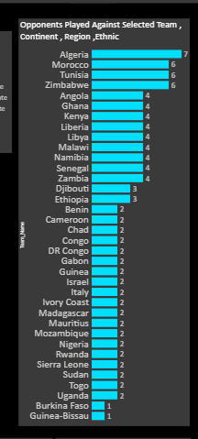
And then I make chart display teams that faces selected team in the tournament

Slide 57
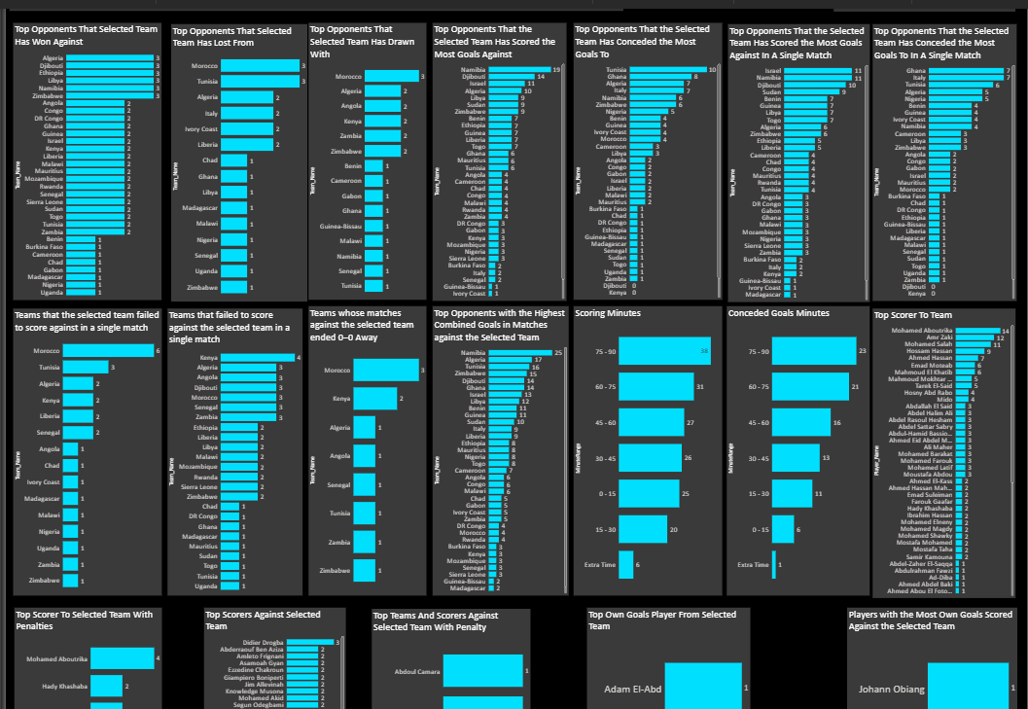
After that, I built a full set of charts that analyze the selected team’s performance against all opponents. These charts include: The teams the selected team has defeated the most The teams the selected team has lost to the most The teams the selected team has drawn with the most The teams the selected team has scored the most goals against The teams that scored the most goals against the selected team The teams the selected team scored the highest number of goals against in a single match The teams that scored the highest number of goals against the selected team in a single match The teams that failed to score against the selected team in a single match The teams the selected team failed to score against in a single match The opponents with the highest number of 0–0 matches with the selected team The teams whose matches with the selected team most frequently included goals (for either side) The minutes in which the selected team most frequently scores The minutes in which the selected team most frequently concedes The selected team’s top scorers The top penalty scorers for the selected team The top scorers against the selected team A drill-down chart showing teams and players who scored penalty goals against the selected team The players who scored the most own goals for the selected team The players who scored the most own goals against the selected team

Slide 58
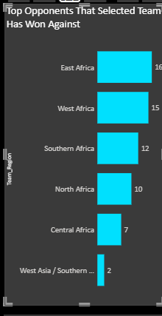
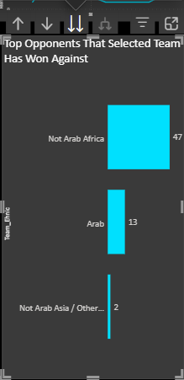
All these charts fully support drill-down functionality across Continent, Region, and Ethnic Group levels. For example, if the chart shows the teams that Egypt has defeated the most in the AFCON Qualifiers, then: Drilling down will show the continents where Egypt achieved the most wins. Drilling down further will show the regions Egypt has beaten the most. Drilling down again will display the ethnic groups Egypt has recorded the most victories against.
Most regions Egypt wins against in africa fifa world cup qualifications
Most ethnic Egypt wins against in africa fifa world cup qualifications

Slide 59
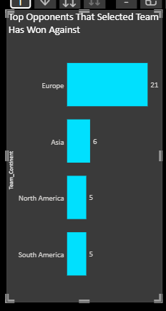



You can filter not only by a specific national team, but also by continent, region, or ethnic group. For example, in the World Cup dashboard, if you select a continent such as Africa, all the charts will update based on that selection. They will show: The teams that African nations have defeated the most The continents they performed best against The regions they performed best against The ethnic groups they performed best against In other words, all these charts respond dynamically to the Continent, Region, and Ethnic filters, not just the Team filter.
Here I make fifa world cup and only select Africa
Here is the most continent Africa won against in world cup and it work with drill down I can know also regions , ethnic , teams

Slide 60

The drill down not only contain teams , continent , ethnics but also cities so when I select team name or any thing from my dropdowns last drill down in my carts have cities example : the chart that represent the most team that selected team wins against at last drill down it will show the most cities that selected team wins in and that work in all charts

Slide 61

Also I make the same charts in home and away competition and that for home competeions

Slide 62

And that for away

Slide 63

Dashboard 3

Slide 64
It is about players I have only three dropdowns one to select tournament and one to select year and one o select player name

Slide 65

When I select player name and tournament such fifa world cup at all without specific year it will show the total goals he scored and goals without penalties and penalties goal and own goals

Slide 66

And then I have 7 charts : top opponent that selected player has scored against oppponent that player scored against in penalty opoonent that player scored against without penalty the most tournament that player has scored goals (if I don’t select any tournament ) top opponent that player scored against at home top opponent that player scored against away top opponent that player scored own goals in (if found)

Slide 67




Also all these charts work with drill down hirachy ex : there is top teams messi scored against and top continent and top region and top ethnic

Slide 68

And also I have pie chart present the most minute range that player scored his goals

Slide 69


Dashboard 4

Slide 70
Dashboard 4 it is individual dashboard and don’t depend on dashboard 1 or 2 or 3 it is for head to head teams or continent or region or ethnic

Slide 71

n this dashboard, you can compare team vs. team, continent vs. continent, region vs. region, or ethnic group vs. ethnic group. You can also compare a team against a continent, an ethnic group against a region, or any other combination you choose. The dashboard automatically generates full head-to-head statistics based on the selected comparison. For example: Arabs vs. Africans Arabs vs. Europe Egypt vs. Algeria Egypt vs. European teams …and any other matchup you want to analyze. You can also switch between viewing the results overall, within a specific tournament, or within a selected time period.

Slide 72

I will perform a search for Egypt vs Algeria, for example, without selecting any specific tournament, so the data will be shown overall (in general) to make the explanation easier.

Slide 73

The first thing is that when you select any two teams, the dashboard will show head-to-head statistics between them, including: The total number of matches played between the two teams Goals scored by Team 1 Goals scored by Team 2 Number of wins for Team 1 Number of wins for Team 2 Number of draws The highest number of goals scored by Team 1 in a single match between them The highest number of goals scored by Team 2 in a single match between them Historical top scorers in the matches between the two teams

Slide 74

The second feature shows the same head-to-head statistics, but only for matches played at the home stadium of the first selected team. For example, in our case, if Egypt is selected as Team 1, it will show the stats for matches played in Egypt. If you want the same statistics for matches played in Algeria, simply switch Team 1 to Algeria, and the dashboard will update accordingly.

Slide 75

After that, the dashboard shows overall statistics, which are not limited to head-to-head matches. For example, it will display: The total number of matches Egypt has won in its history The total number of matches Algeria has won in its history Total wins, losses, and draws for both teams overall Total goals scored and conceded by each team Total clean sheets achieved by each team The highest number of goals scored by each team in a single match Historical top scorers for both teams (Egypt and Algeria) This provides a complete overview of each team’s performance over time, independent of direct encounters.

Slide 76

The same statistics are also available for home matches only.

Slide 77

The same statistics are also available for away matches

Slide 78
Remember that you can select any combination from the dropdowns, not just teams. For example: Continent vs Continent Team vs Continent Region vs Region Ethnic Group vs Ethnic Group Team vs Region, etc.

Slide 79

Finally, there is a comparison feature between two selected players. The dashboard will show: Goals scored by each player Number of matches played by each player Goals scored from penalties and non-penalty goals Number of own goals scored by each player Number of different teams each player scored own goals against Goals scored at home and away for each player This allows a detailed side-by-side comparison of the players’ overall performance, both home and away.

Slide 80
Conclusion
This project was developed through four main phases:
1) Data Description & Understanding
In the first phase, I analyzed and documented the full structure of the raw dataset, including match details, teams, players, goals, venues, and tournament information. I explored field meanings, identified missing values, detected inconsistencies, and mapped relationships between tables to fully understand how football historical data is organized.
2) Data Cleaning & Transformation
The second phase focused on preparing the data for analysis. I cleaned the dataset, fixed date and score formats, handled null values, corrected team and tournament naming issues, and standardized all categorical fields. I also engineered several new columns to enable advanced analytics (such as goal types, home/away indicators, clean sheet flags, match outcome columns, scoring-minute categories, and more).
3) Data Warehouse
After preparing the data, I designed a structured data warehouse that follows a dimensional modeling approach. I built fact tables for matches and players, along with multiple dimension tables such as teams, tournaments, dates, continents, regions, ethnic groups, and stadiums (cities). This model enabled Snowflake-style hierarchies and allowed all dashboards to use drill-down functionality from continent → region → ethnic group → country.
4) Data Visualization & Dashboard Development
In the final phase, I designed and built an interactive Power BI dashboard system that includes tournament statistics, team performance analysis, head-to-head comparisons, player analytics, and home/away breakdowns. The dashboard supports drill-down exploration, dynamic filtering, and detailed insights across tournaments, continents, regions, ethnic groups, teams, and players.

Slide 81
Final Result
This project provides complete historical statistics for all national teams, helping users understand participating teams, compare performances, and explore every detail about any national team throughout football history.

